Slide 1
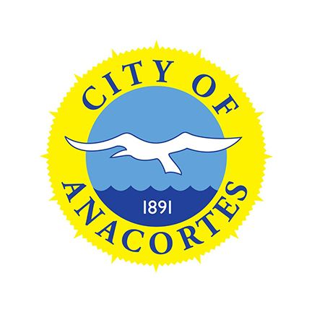
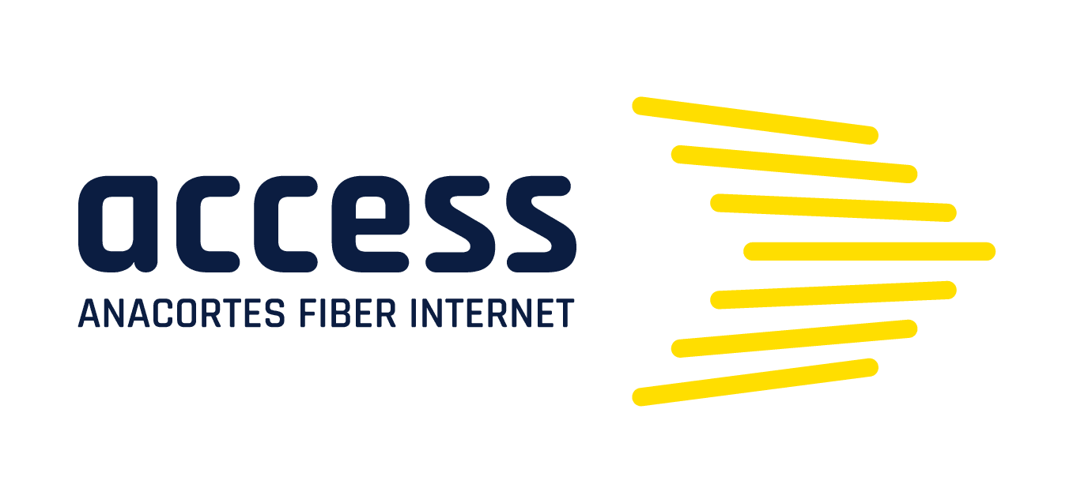
Anacortes’ Fiber Internet Business Model
Bruce McDougall
Anacortes City Council
December 15, 2021

Slide 2
Access Anacortes Fiber Optic Internet Business Model
Fundamental Goals:
Building Confidence
Offer the community a truly valuable service with great customer support
Take control of our digital future
Fastest path to return on investment (ROI) and profitability
Path to Achieve Our Goals?

Slide 3
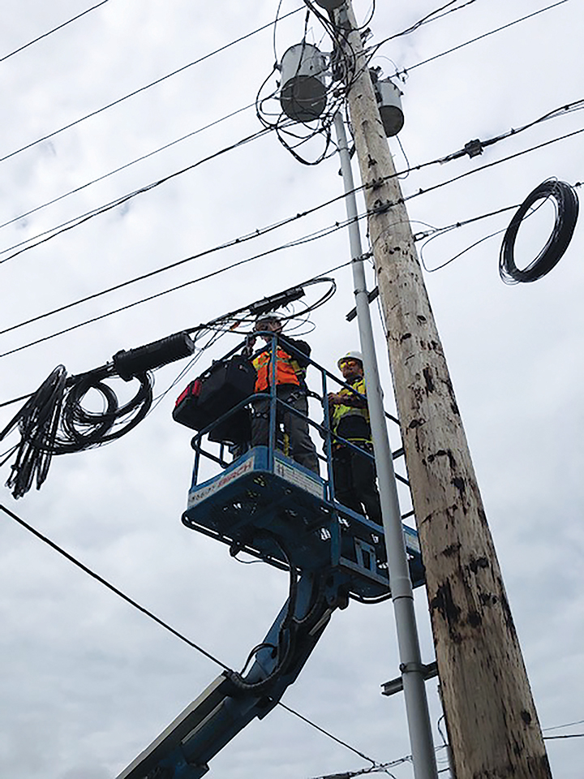
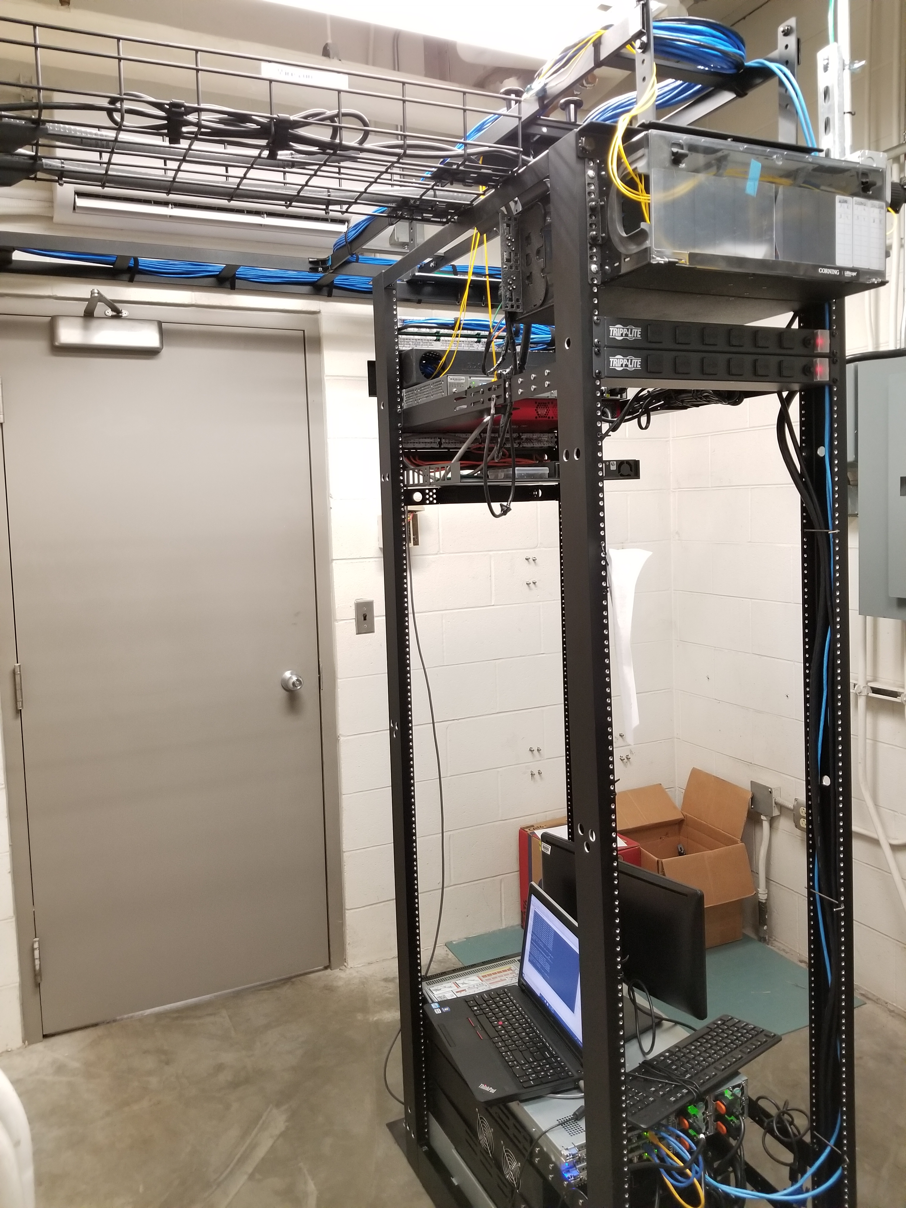
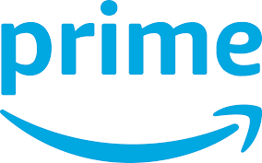
What is a Community Owned Broadband Network?
Key question: what work do we keep in-house, and what work is better suited to partners?
A Big Construction Project
Some Technology
Ongoing Customer Support

Slide 4
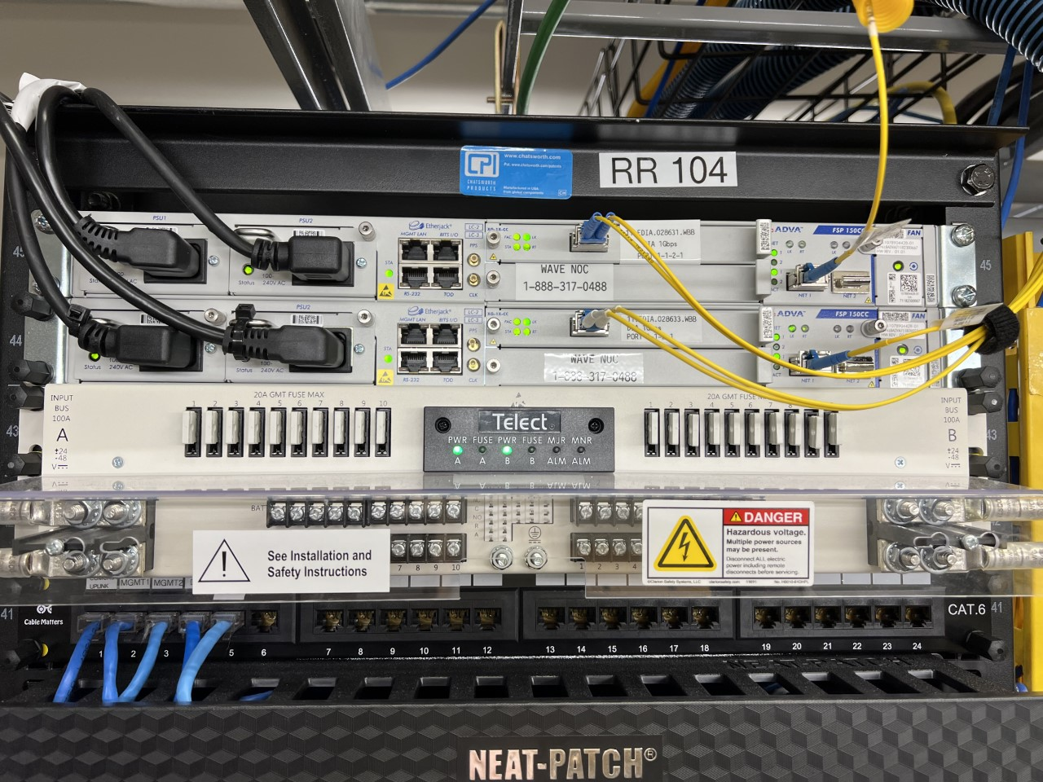
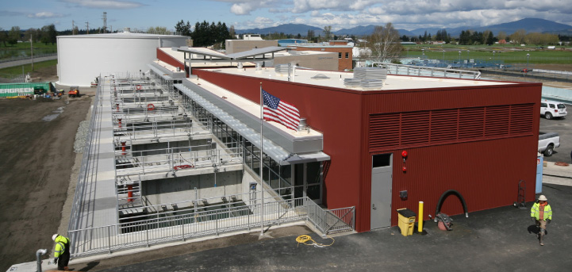
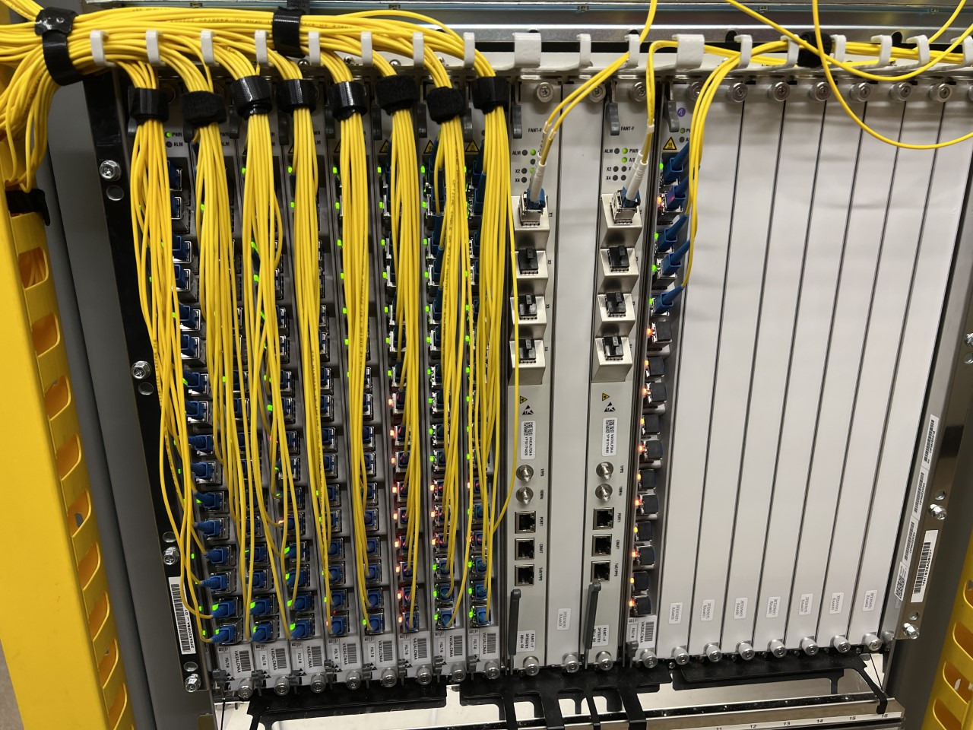
Should We Be Daunted By the Technology?
Our ISP Equipment
Our Water Treatment Plant
vs.

Slide 5
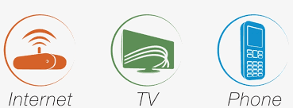
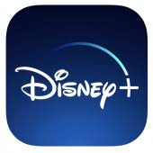
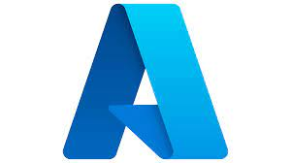
What Service(s) Should We Offer?
Value shift from ISP-driven bundles to Internet Apps
Broadband 1.0
Broadband 2.0

Slide 6
Access Anacortes Fiber Optic Internet Business Model
Fundamental Goals:
Building Confidence
Offer the community a truly valuable service with great customer support
Take control of our digital future
Fastest path to return on investment (ROI) and profitability
Path to Achieve Our Goals:
Full FTTH / FTTP
Internet Only
In-House “ISP”
Partner for operational scale:

Slide 7
Thank you

