Slide 1
Operating A Network: 101
Notes:
Click Icon or Drag the picture and Right Click> Send to Back

Slide 2
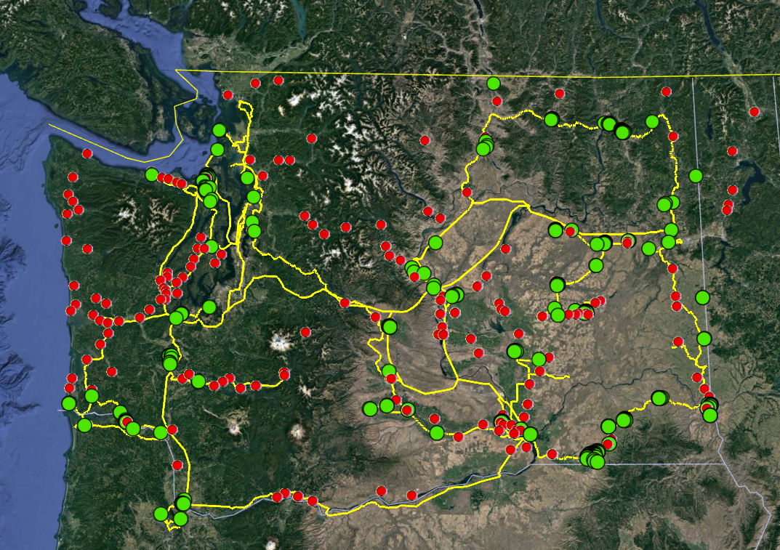
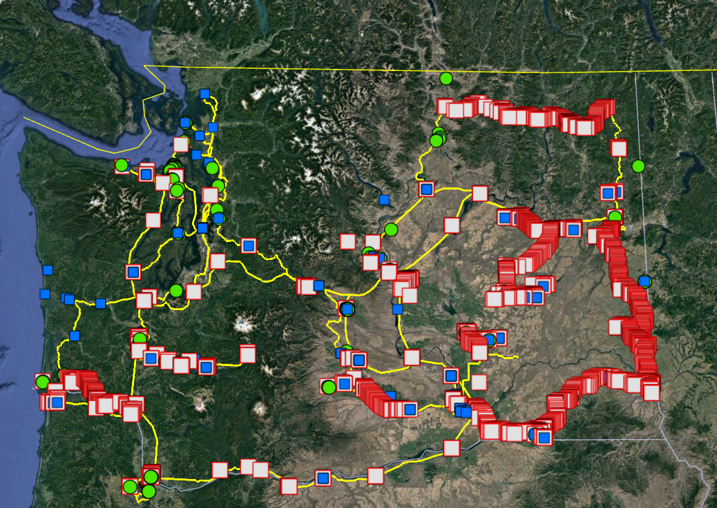
Contents in a Network?
Inside Plant & Outside Plant
NoaNet has over 3,300 miles of network plant that touches every county in Washington State.
Cell Towers
Roadside cabinets
Data Centers
Co-locations
Point of Presence (Pops)
Fiber Patch Panels
Routers
Switches
Generators
Rectifiers
HVAC
UPS
Batteries( 8 Hours)
Notes:
Start of with how Chris Walker talked about the different aspects of a network
Access Network
Middle Mile
Long Haul
(Cabinets, Splice Cables, Etc.)

Slide 3
Build your Framework
Provides guidance on identifying, planning, delivering, improving and supporting the services we provide.
ITIL Service Management
Information Technology Infrastructure Library
eTOM
Agile
Notes:
We need a Framework, we need guidelines to operate under.

Slide 4
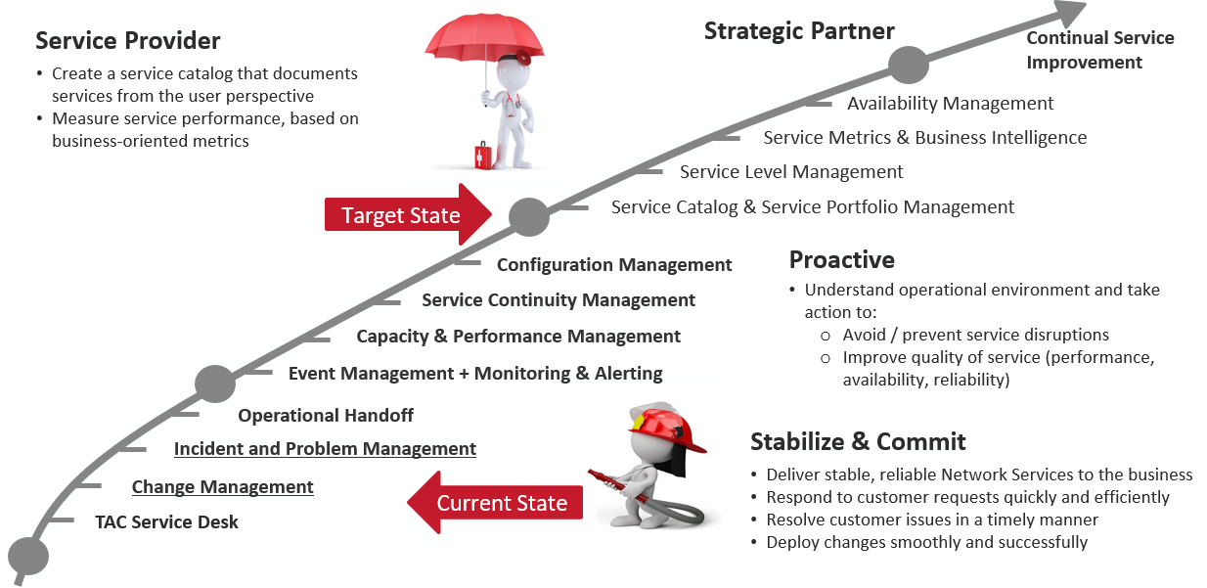
Service Management Glide path
Notes:
Build from a foundation of strength. Having effective Service Management processes in place will allow Operations to pursue activities such as innovation and drive the business forward.

Slide 5
Understand How Work Flows through the Business
Inputs
Outputs
Plan
Build
Run
REQUEST
RELEASE
EXPERIENCE
Business Requirements
Customer Loyalty
Portfolios and Roadmaps
Service Support
Business Process
Develop Solution
Capacity & Financials
Operation & Maintenance
Quality & Cost
Operational Readiness
Technology
Service Acceptance
Demand & Design
Service Improvement
Customer Feedback
& Data
Notes:
An organization is a complex system for delivering value. And an operating model breaks that complex system into components, showing us how it all works and how we get from end to end.
It will also help leaders identify problems that are causing under performance in delivery or support process.
The most underutilized component of an operating model is what I call service acceptance.
The framework acts as quality gate to our products and services, everything we deliver into operations cycles through the framework with defined business inputs.

Slide 6
Service Level Management The Backbone of Operations
Service-Level Agreements / Inter-Local Agreements
Service Based
Customer Based
Circuit Based
Multi-Level
Operating-Level Agreements
Respond within 30 minutes
Identify/Resolve Issue within 4 Hours
Maintain 99.999% Availability
Underpinning Contracts
Vendor Agreements
External Agreements
Customer
SLAs
Service Provider
OLA
Underpinning Contracts

Slide 7
Organizational Overview
Business
Sales
Product
HR
Design Eng.
DEVOPS
Infrastructure
Security
CB
Sourcing
Finance
OSP Construction
Service Management
Data
Service Operations (NOC)
(Event, Incident, Problem, Change Management)
Field Service Delivery
(Field Engineering, Facilities, Sites, Dispatch, Implementations)
Service Assurance
(Systems, Proactive Improvements, Process & Procedures)
Wireless
Wireline
Preventative Maintenance
Governance
1
Site Agent / Smart Hands
Managed NCS Services & Customer Care
Preventing Outages
KPIs
DevOPS
Tiered Model
Asset Management
Lifecycle Management
Tools/Telemetry
(Process & Delivery)
Quality Assurance
Support Applications
Enhanced Telemetry
Enhanced Correlation
Field Engineering
Warehouse & Procurement
Performance Metrics & Analytics (Reporting)
Customer Experience
Notes:
So how do you take the complexity of 20 years of intertwined technology and transport and build a great customer experience, focused on reducing the mean time to restore while keeping the design, inventory and tribal knowledge into a sustainable long term program? By building an industry standard best practice service management program.
This is an overview of how service management interacts with the entire organization and how the organization supports service management.

Slide 8
The NOC “The Insurance Policy to the Company”
8 | Proprietary and Confidential
Notes:
This takes us to the Functions of a Network Operations Center.

Slide 9
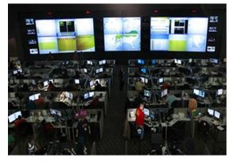
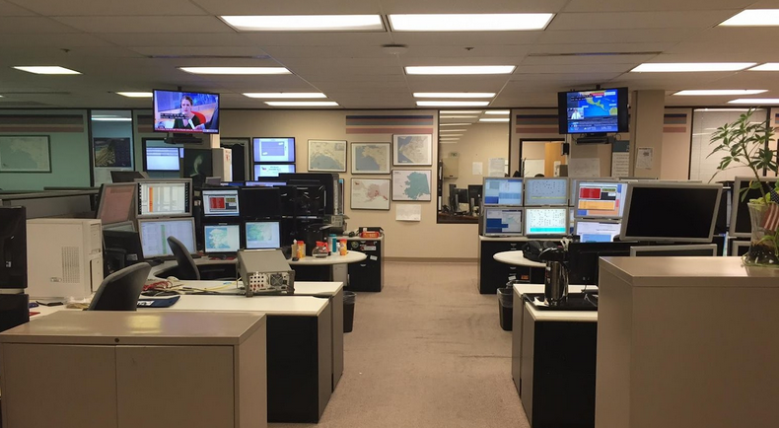
What does a Network Operations Center look like?

Slide 10
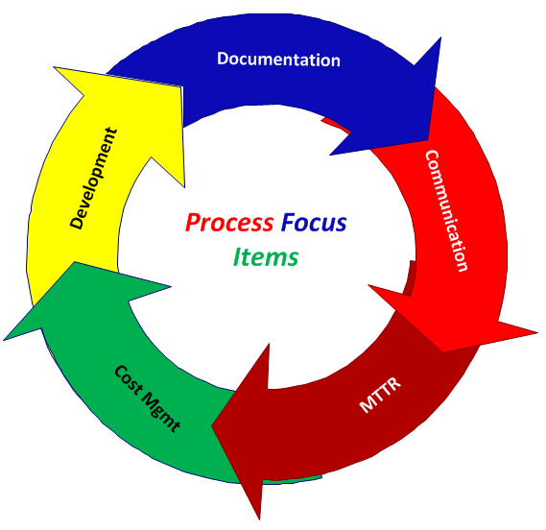
NOC Support Model
Network Management
Customer Care
24x7x365 Awareness
Awareness of Customer Needs & Tendencies
Service Level Agreements (SLAs)
Maintenance (Reactive & Proactive Prevention)
Escalate internally and externally as needed to expedite repairs and awareness
Evaluation of data to determine trends, chronic devices, regions, timeframes
Network focused operators
Answer all incoming service-related calls
Troubleshoot customer service issues- even those that are not our problem
Keep customers updated on trouble resolution progress (email preferred)
Escalation of severe or chronic customer issues; create performance improvement plans in collaboration with the Product owner, incld. Engineering & Field resources.
Customer focused operators
Systems
Service Management
24x7 means “24 hours a day, 7 days a week” and is used to describe a service or department, such as network operations, that is continuous, is always available (day or night), or involves products that should run without disruption or downtime.”
Notes:
When building a NOC support model, I put the majority of the attention toward the following as I needed a common thread (or threads) to drive a common end.
Network Management: How do we manage, maintain and operate our devices & connectivity?
Customer Care: What are our Customer goals and how do we impact that positively and negatively? Are we efficient, consistent in our message? Are we contributing to churn or are we contributing to retention? From a NOC perspective, as you know, you’re contributing to both, but which one are your efforts aligned with?
Systems: Are our systems enabling us to concentrate on the items we’ve identified as necessary to be a successful NOC? Do they enable our clients to be successful? Have we automated action where we can and where it counts?
Service Management:
With identifying these (4) key aspects, I needed a common thread (or threads) to drive a common end.
My initial focus drivers were the same then as they are today...we maintain a constant awareness of how our actions and efforts impact the following…
Documentation
Communication
MTTR
Cost Management
Development
I feel that as long as all processes and considerations maintained an awareness of these (5) drivers, we were on the right track.

Slide 11
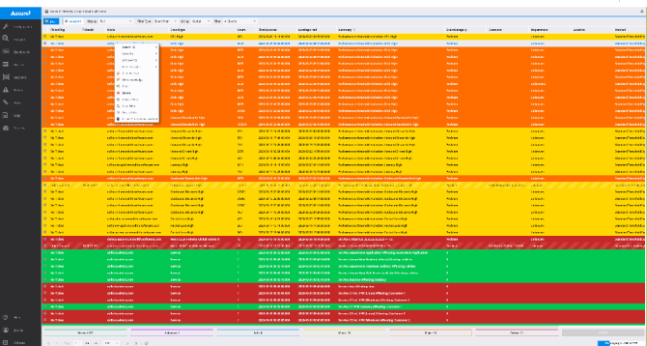
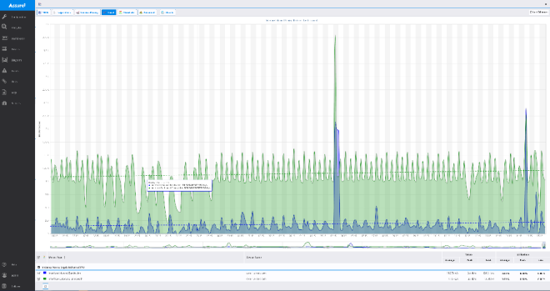
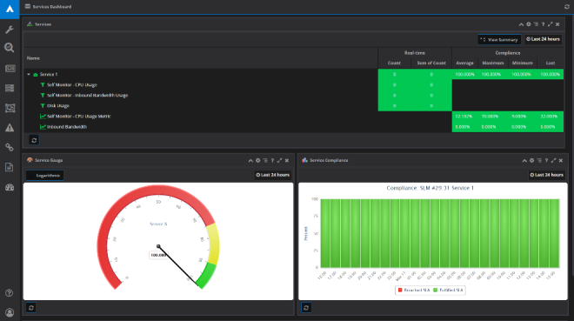
Your Tool Box
Fault Management
Performance Management
Service Assurance
List of alerts for manager to resolve
Uptime statistics of network over time
Top-down view of network performance
Customer and Circuit Information
Outside Plant Information
ITSM

Slide 12
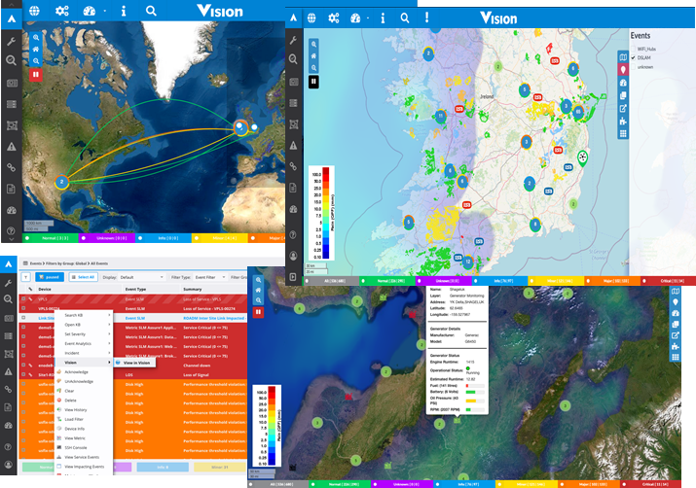
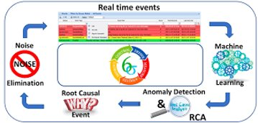
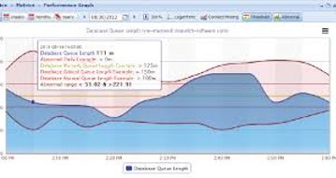
Single Pane of Glass
Notes:
Due to 20 years of technology, most of which is still providing service today, the large tool box of OSS systems we’ve created to solve our visibility problems, we now must consolidate the tool set and reduce the noise by building logic and over the top dashboards while integrating machine learning with a single trusting and scalable service management and inventory tool.
We must build a single CMDB and inventory system with clean data that has been internally audited for accuracy.
And a Governance operating model and process that does not allow deviation over to any other set of unapproved processes or tools.

Slide 13
Service Level Agreements
Tier I Analysts
Wireless
Transport
IT
Facilities
Managed Customers
Operational Level Agreement
(Operating Model)
Tier II Technicians
Communications
Tier 0
Tier III Engineers
Tier IV
Operational Level Agreement
Engineering & Vendor Support
Notes:
Support Model in Action
Take note how SLAs have a role.
911 SLAs
TSP Coded Circuits ( Telecommunications Service Priority mandated through an FCC program for qualify customers)
High Priority Customers

Slide 14
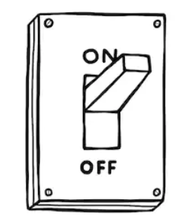
Be the Voice of the Customer
Our customers expect a Service
Notes:
A lot of times we find ourselves stuck between the network is up VS the service is down/degraded VS a customer waiting on hold VS taking 60 days to turn up a services, etc.
Which why its all about customer experience and having a strong pulse on the end to end journey.

