Slide 1
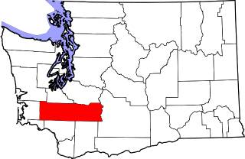
Mapping the Broadband Problem in Lewis County
Our Approach to Planning
Life Was Great
Timeline
Our Plan
Partnerships and Collaborations
Lessons Learned

Slide 2

Life Was Great
Expanded our reach between offices
Lease excess capacity
Over 88 Miles Installed
Over 400K in annual revenue
Minimal Overhead or Involvement by Staff
2019 Added Telecommunication \ Broadband to our Strategic Plan
“What is our Goal for Telecommunications \ Broadband for Lewis County?”
Realized we didn’t have the answer….

Slide 3
Timeline
Sept 2019 Asked A Question
Sept 2020 Applied for 1st Grant
Today
Nov 2019 CERB Grant
Sept 2019 Asked A Question
June 2020 Survey Complete
July 2021 BB Plan Complete
Business As Usual
March 2020 COVID
January 2021 Broadband Plan
2019
2020
2021
Technical Services (Hardware)
  Kick-Off: 3/12/21
  Technical Configuration: 3/12/21 – 4/29/21
  Training: 4/23/21 – 4/29/21
  Live: 5/10/21
Accounting (ABS)
  Kick-Off: 3/1/21
  Analysis & Configuration: 3/29/21 – 10/29/21
  Training: 4/19/21 – 12/10/21
  Testing: 5/10/21 – 12/10/21
  Live: 12/13/21
Mapping (MapWise)
  Kick-Off: 5/3/21
  Analysis & Configuration: 5/3/21 – 12/13/21
  Training: 11/23/21 – 12/16/21
  Testing: 12/13/21 – 2/25/22
  Live: 2/7/22
Customer Care (CC&B)
  Kick-Off: 10/4/21
  Analysis & Configuration: 10/4/21 – 4/11/22
  Training: 1/10/22 – 3/25/22
  Testing: 2/1/22 – 3/25/22
  Live: 4/11/22
Outage Management (OMS)
  Kick-Off: 11/1/21
  Analysis & Configuration: 11/22/21 – 5/20/22
  Training: 3/7/22 – 4/8/22
  Testing: 4/4/22 – 6/24/22
  Live: 5/16/22
Accounting and Business (ABS)

Slide 4
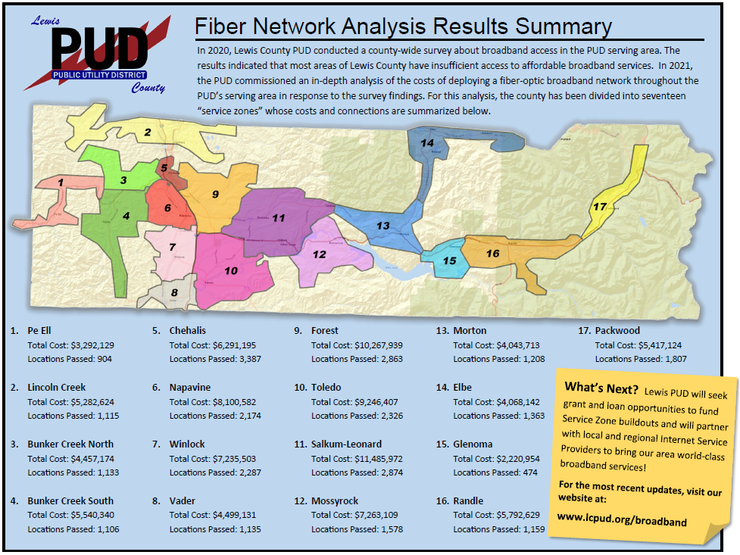
Our Plan

Slide 5
Partnerships and Collaborations
Utilize existing partnerships and contracts
  NoaNet
  Toth \ Power Engineers
  Purchasing contracts
Collaborate and Communicate
  ToledoTel
  Lewis County
  Broadband Action Team

Slide 6
Lessons Learned
You “probably shouldn’t” do everything yourself
Know what resources you have access to and the limitations of these resources
Ask questions and listen when people are talking
Partnerships are very important
Make sure you have a clear vision of what you are doing
Communicate
Not everyone will agree
Know what type of business model will be supported

Slide 7
?
Thoughts and Feedback

