Slide 1


Slide 2
Who Is CERB?
^{Investing in}
^{Washington’s Economic Future}
Notes:
CERB was created in 1982 to invest in public infrastructure that supported private job creation
CERB is a 20-member independent rule-policy making board, meets 6 times per year and is designed to respond to immediate business needs for siting and expansion
The Board is comprised of small and large business members across the state, representatives from Ports, Counties, Cities, Tribal, Public, and an Economist. CERB also has legislative members, and state agency members.
CERB accepts applications on on-going basis, first-come, first-served. Board approves projects at every meeting.
CERB is a revolving loan fund
CERB is housed within the Department of Commerce.

Slide 3
CERB is designed to:
Finance public infrastructure construction to support private business development
Assist local governments with economic development and broadband planning
Finance public broadband infrastructure to provide high-speed, open-access service for rural underserved communities.

Slide 4
CERB Administered Funding Programs
Planning Program
Grants
Committed Private Partner
Loans/Limited Grants
Prospective Development
Rural Broadband

Slide 5
Programs
Planning
Economic Development
Broadband
Committed Private Partner
Private business needs public infrastructure to:
Site, expand, be retained
Prospective Development
Planning has been completed and project is deemed feasible
Public infrastructure is needed to:
Create and retain jobs
Complete private capital project
Recruit private industry to the community
Job creation
Private Investment
Rural Broadband
Planning has been completed and project is deemed feasible
Project is in a rural county/ community
Project is in unserved or underserved area
Project has a committed ISP

Slide 6
Eligible Public Facility Projects
Activities
Acquisition
Repair
Systems: Improvement of:
Bridges
Construction
Replacement
Roads
Sanitary Sewer
Storm Water
Transportation
Building or Structures
Broadband/Telecommunications
Domestic & Industrial Water
Earth Stabilization
Railroad
Electricity
Natural Gas
Port Facilities
Reconstruction
Rehabilitation
Planning for all activities & systems

Slide 7
Drive job creation, promote innovation, and expand markets for local businesses; or
Serve the ongoing and growing needs of local education systems, health care systems, public safety systems, industries and businesses, governmental operations, and citizens; and
Improve accessibility for underserved communities and populations.
Purpose

Slide 8
Cities & Towns
Counties
Federally Recognized Indian Tribes
Municipal & Quasi Municipal Corps
Port Districts
Special Purpose Districts (e.g. PDAs, PUDs)
Eligible Jurisdictions
Notes:
All Local Governments and Federally Recognized Tribes

Slide 9
Rural Broadband 2018-2021
$37.8 million
CERB Investment
$23 million
Match Funding
28 Projects
72 Communities
5 Towers
500+ Miles of Fiber
21,112* Connections
$1,793 Cost per Connection
136 ISPs
*19,608 are household connections that facilitate virtual education, ecommerce, telework, and telemedicine

Slide 10
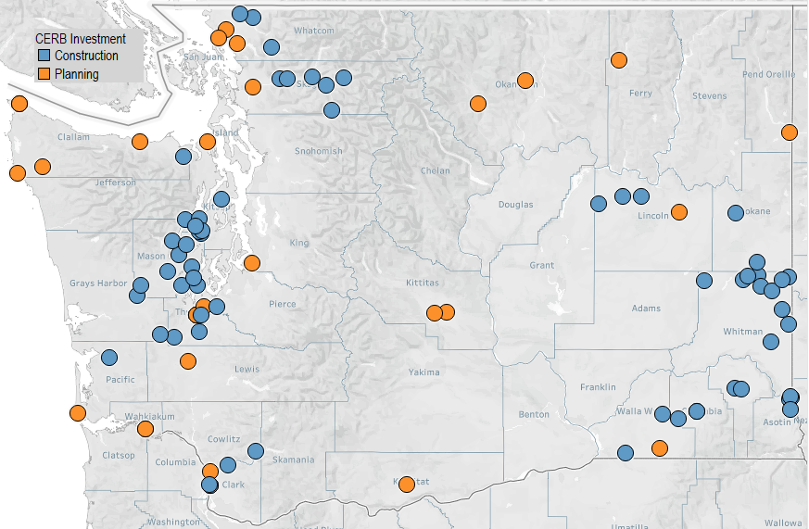
$37,847,907 Invested
27 Projects
72 Communities
21,112 Connections
136 ISPs
5 Towers
500+ Miles of Fiber
$1,793 Cost per Connection
Avg. Project $1,645,561

Slide 11
Rural Broadband 2018-2021

Slide 12
Rural Broadband 2018-2021
CERB Investment
Increased Connectivity for the Unserved/Underserved
Modernize Local Economies
Serve ongoing and growing needs of Community Systems
Online Educational Opportunities
- Brings Local Business To Global Markets
- Enables Individuals to Start & Grow Businesses
-Telework Opportunities
- K12 Remote Learning
- Homeschooling
-Online Higher Ed
- Increases Access to Economic Opportunities
Connects Local Law Enforcement, Government, and Healthcare
Diversity, Equity, Inclusion –
Increases access to affordable services, devices, & training.
Direct Benefits
Community Impacts

Slide 13
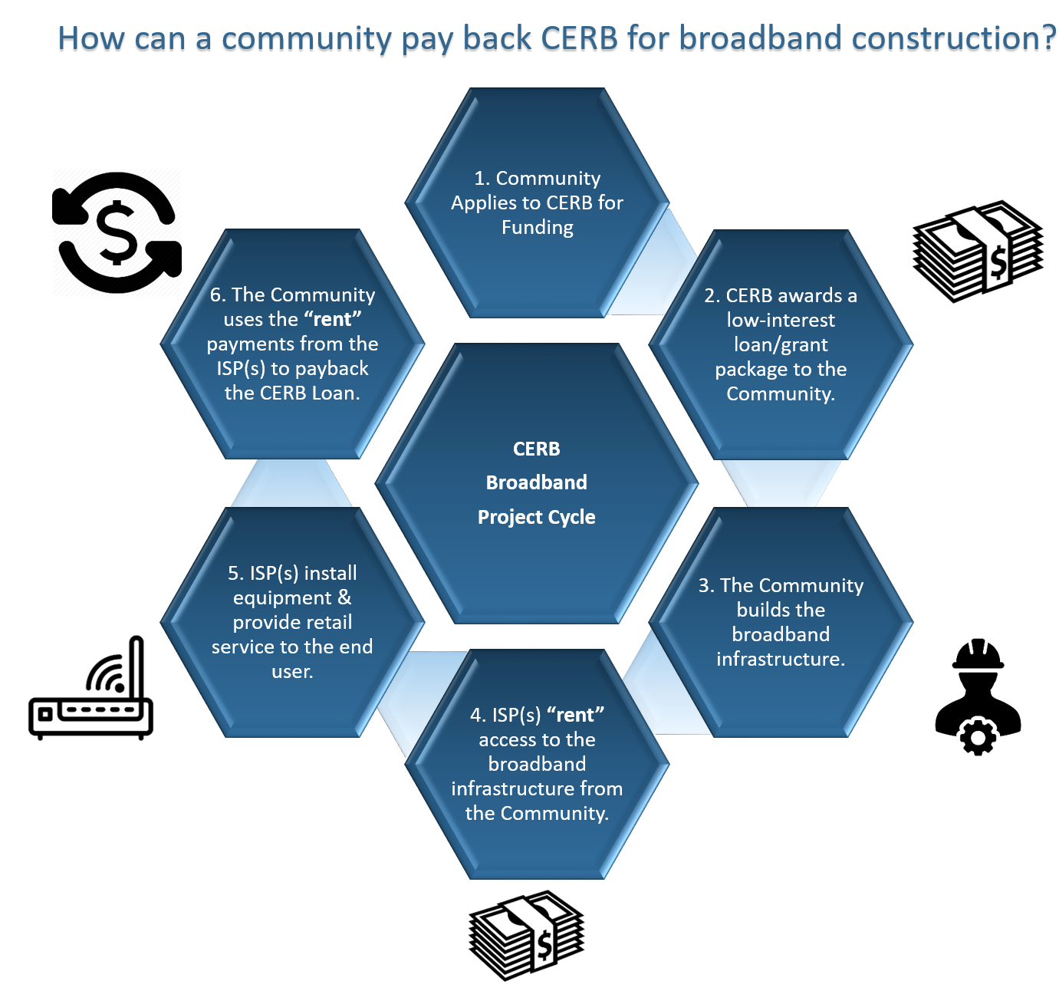

Slide 14
How CERB works
Technical Assistance (TA)
Applications
Applications are due 8 weeks prior to a meeting.
CERB
The Board meets to review applications every two months.
Staff works with the client to vet the application and project.
The applicant presents the proposal to the Board.
The applicant will know at the meeting if their project is approved.
Staff provides technical assistance to communities for project development.
CERB Tracks ALL Projects for 5 years AFTER Completion

Slide 15
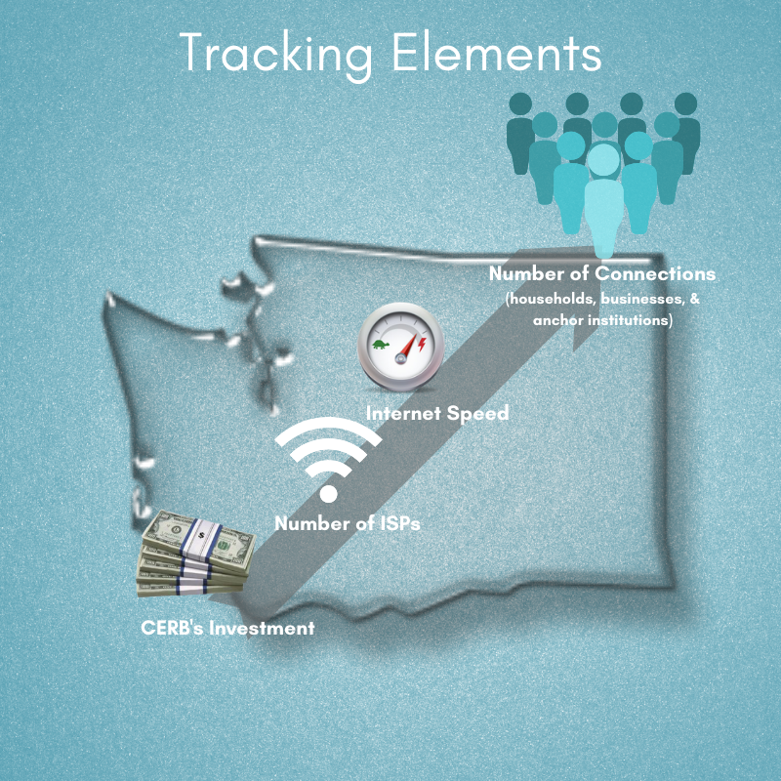
Project Tracking
Tracked for 5 years after a project is complete.
Notes:
2020 Legislative Report Due December
CERB staff tracks ALL projects for up to 5 years after project completion
CERB’s project tracking is a very unique nexus of the program.
Construction projects are tracked on average for 9 years.
The data collected is reported to the legislature in the Boards biennial report.

Slide 16


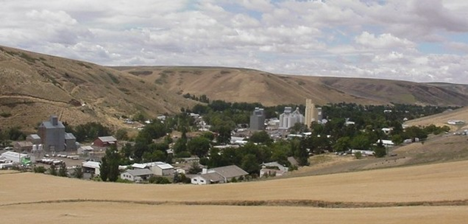
January 2019 - This project consists of engineering and construction of dark fiber infrastructure on aerial poles with last mile components in the City of Pomeroy. Their partner Internet Service Provider is Pocket iNet Communications, Inc. (Success Story Video)
Population: 1,263 (2019)
Project Completed: March 2021
March 2021 Outcomes – 1G/1G
Households | 598
Businesses | 78
Anchor Institutions | 8
TOTALS | 684
ISPS | 3
Project Funding
CERB Grant | $137,500
CERB Loan | $412,500
Match | $300,000
Project Total | $850,000
Notes:
4/2021 - Several homes have been sold, now that there is an option for telecommutting. The Garfield County Hospital is launching a telehealth cardiology program, in addition to their telehealth program. Also there is a benefit for the Emergency Management of Wildfires, providing a command center with the ability to have mapping. This allows students to homework at home, and not have to stay late at the school.

Slide 17
THANK YOU!
Janea Delk
Executive Director & Tribal Liaison
360.725.3151
janea.delk@commerce.wa.gov
www.commerce.wa.gov/CERB

