Slide 1
Port of Whitman County Broadband Model
Kara Riebold
December 16, 2021

Slide 2
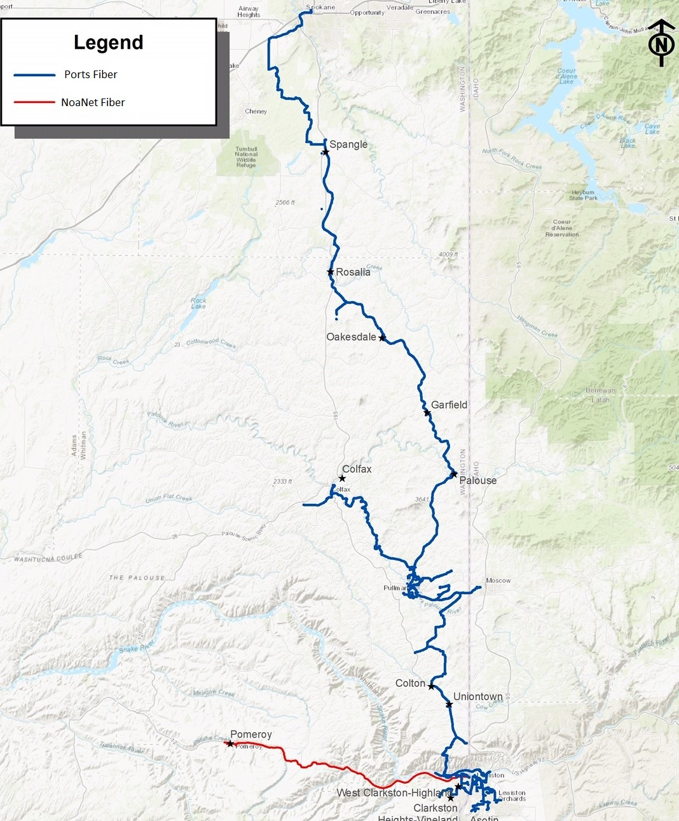
The Port Model in Action
The Port of Whitman County has built out over 300 miles of dark fiber in a network ranging from the City of Spokane in the north to the City of Clarkston in the south.
As a result, the city of Pullman, WA alone has:
14 carriers
Open access network
Free trade environment

Slide 3
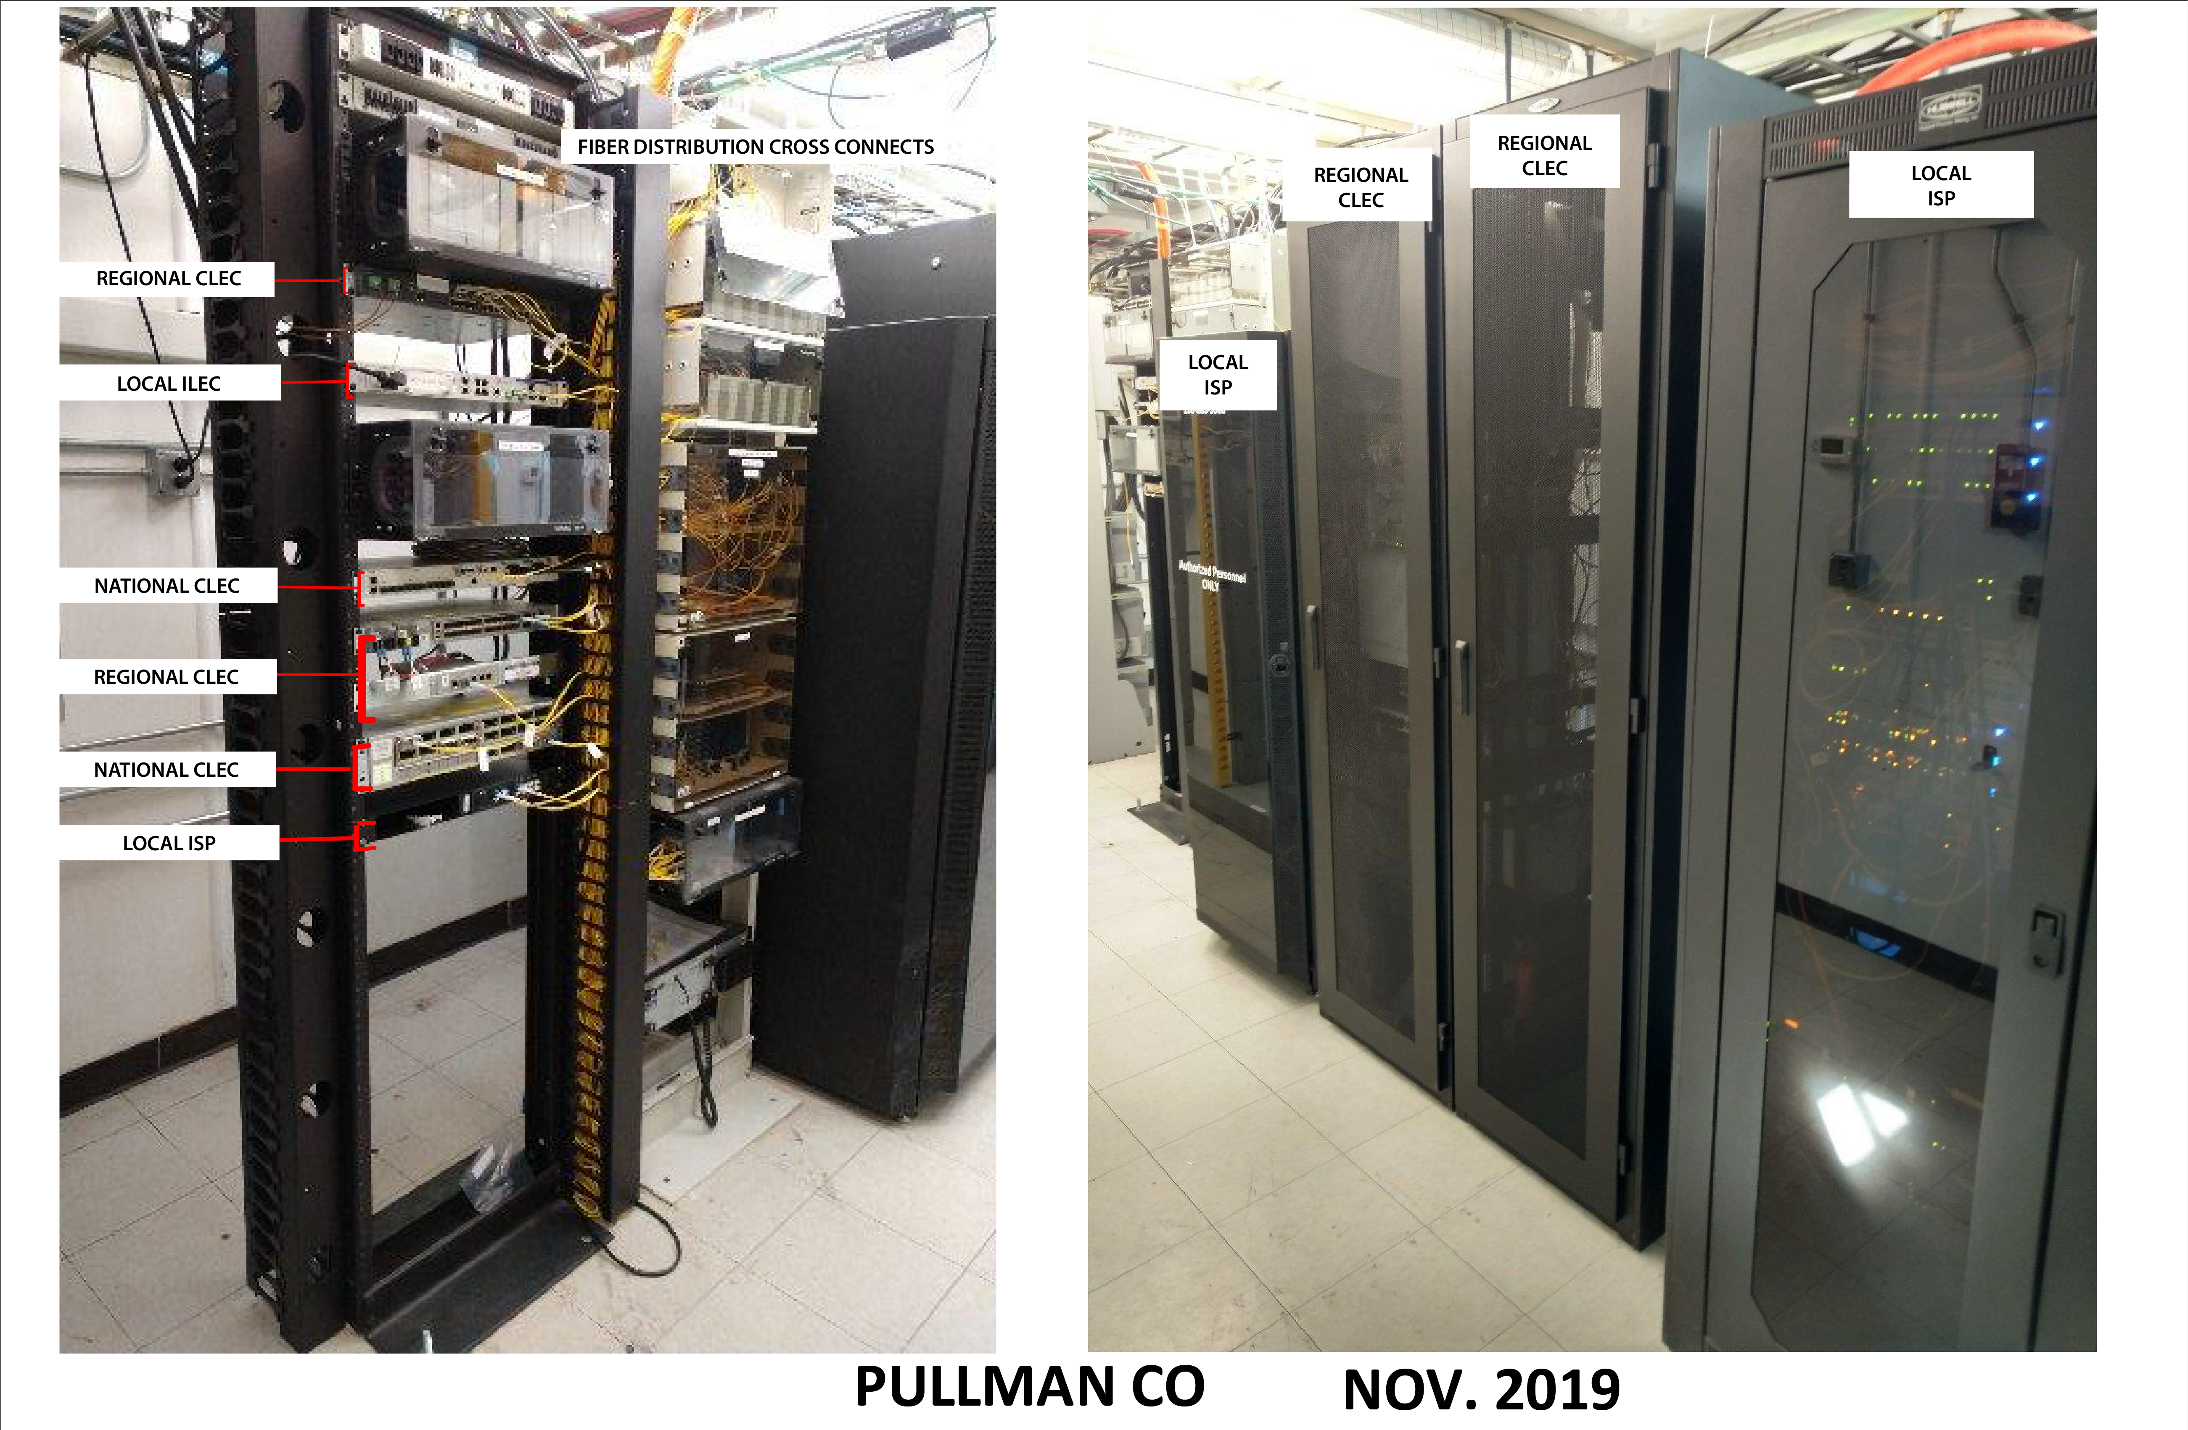
Our Co-Location Facility
There are companies ready to invest in underserved markets, showing that the problem of broadband services can be solved by working together.

Slide 4
Whitman County Fiber-to-the-Home Project

Slide 5
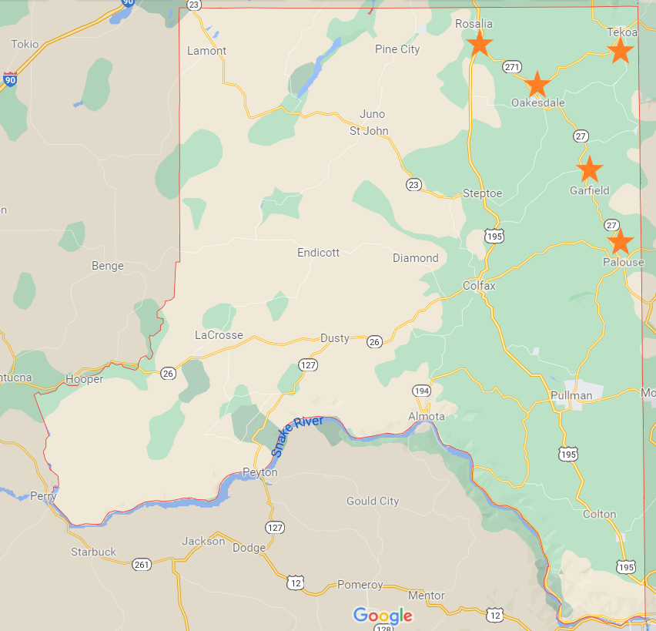
Map of Towns
Palouse
Garfield
Oakesdale
Rosalia
Tekoa

Slide 6
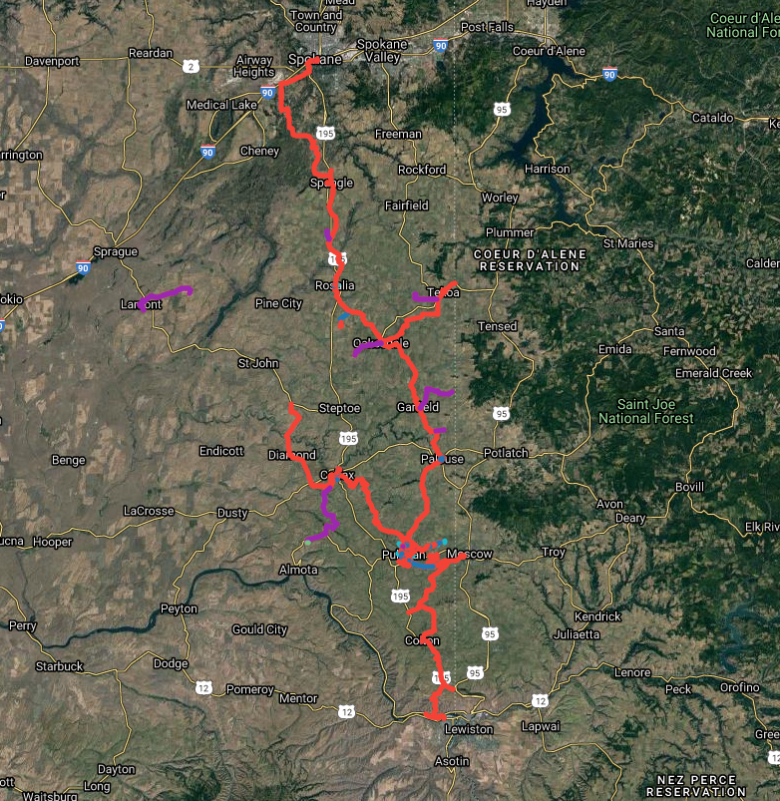
Map of Fiber Network & Extensions
Red represents the Port’s fiber network
Purple represents the tower extensions

Slide 7
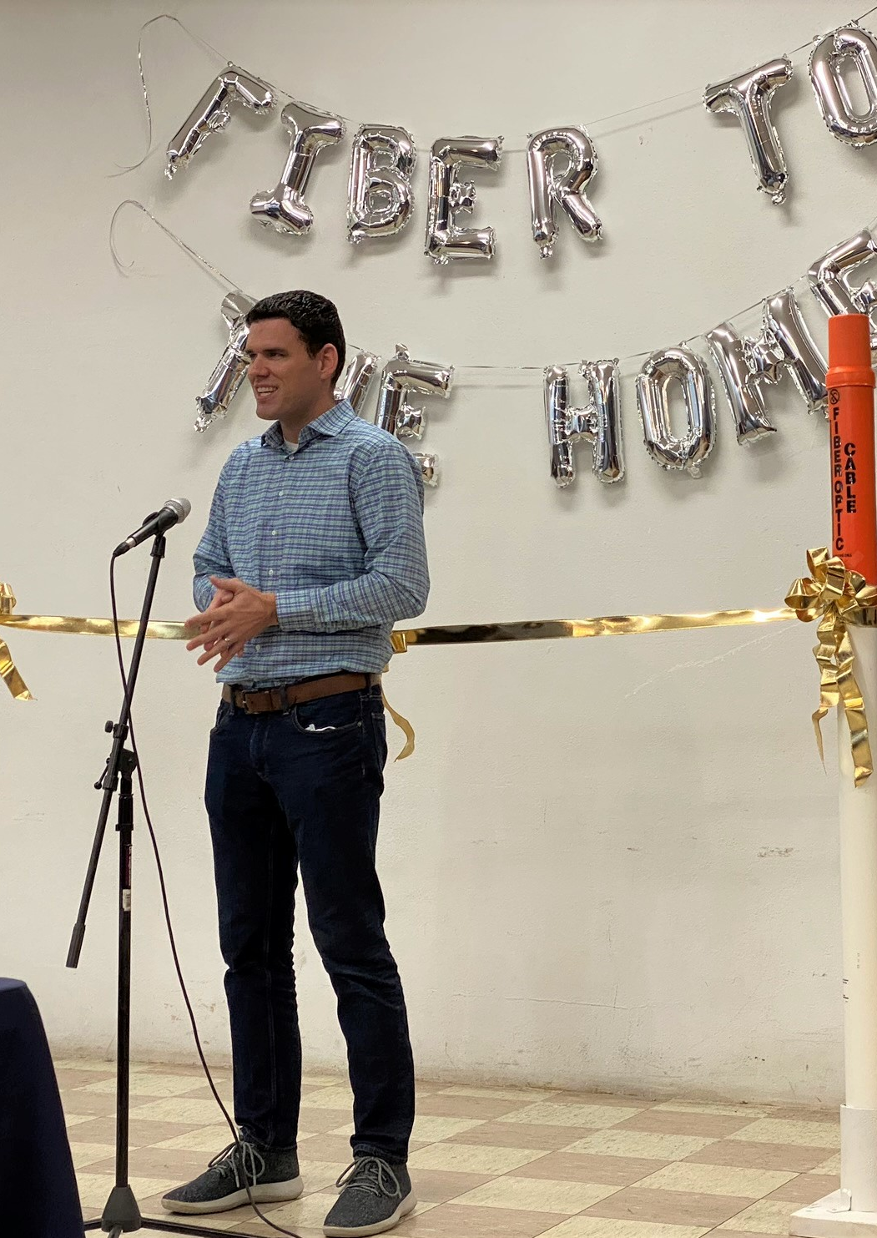
Project Benefits
“This morning, I was able to send 15 Gigabits of imagery data over to a company in Sweden and also be on a Zoom call with them while doing it. Stuff like that makes it possible for anyone to do anything out in the country.” - Andrew Nelson, Owner of Nelson Farms and Silver Creek Farms and Software Engineer from Farmington, WA

Slide 8
Pomeroy Fiber-to-the-Home Project

Slide 9
Pomeroy Fiber-to-the-Home Map

Slide 10
Project Workflow
Provider Request for Quote
Port Provides Quote
Service Order
Construction
Fiber Assignment

Slide 11
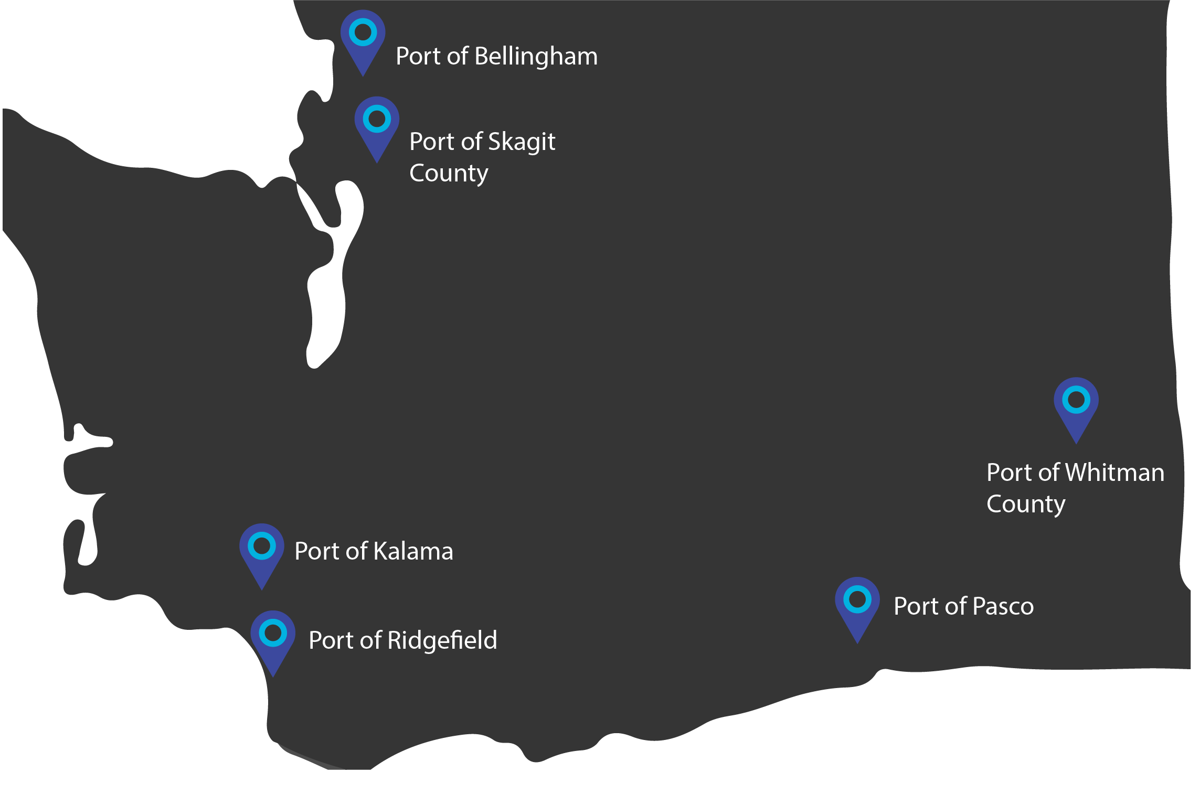
Petrichor Broadband Partners

Slide 12
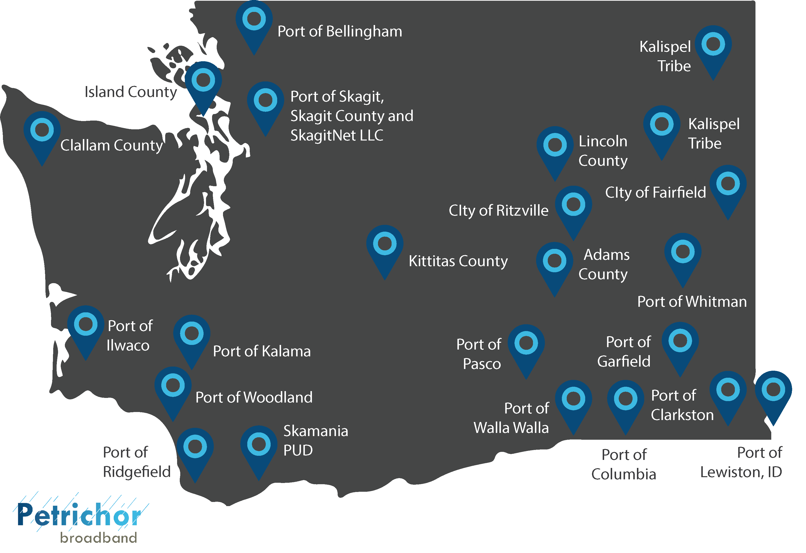
Petrichor Broadband Clients
Interactive Petrichor Broadband Clients Map

Slide 13
Tips for Success
Partner
Stay Predictable
Plan for Future Growth

Slide 14
Questions?
Thank you!

