Slide 1

Broadband 101:
Terminology, technologies, and other need-to-know broadband basics

Slide 2

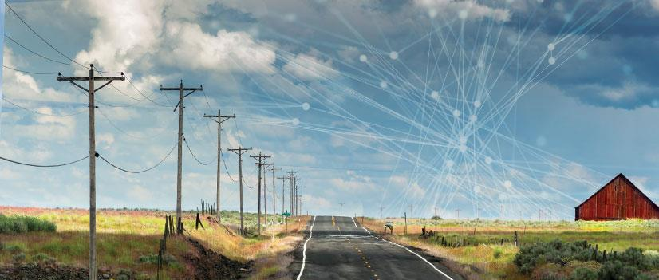

A Public Utility Consortium Serving Washington State with Broadband and Next Generation 911 Services
How the Northwest connects
MIKE HENSON
Chief Operating Officer
CHRIS WALKER
Senior Executive Director, Infrastructure Strategy

Slide 3
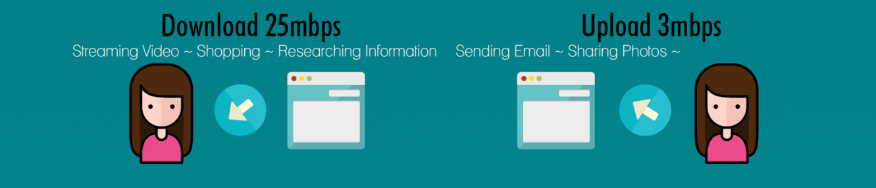
What is Broadband?
ACCORDING TO FCC JAN 2015: 25/3mbps
2028 WASHINGTON STATE BROADBAND OFFICE GOALS:
  150/150mbps to every residence
  1/1Gbps (1000/1000mbps) to businesses

Slide 4
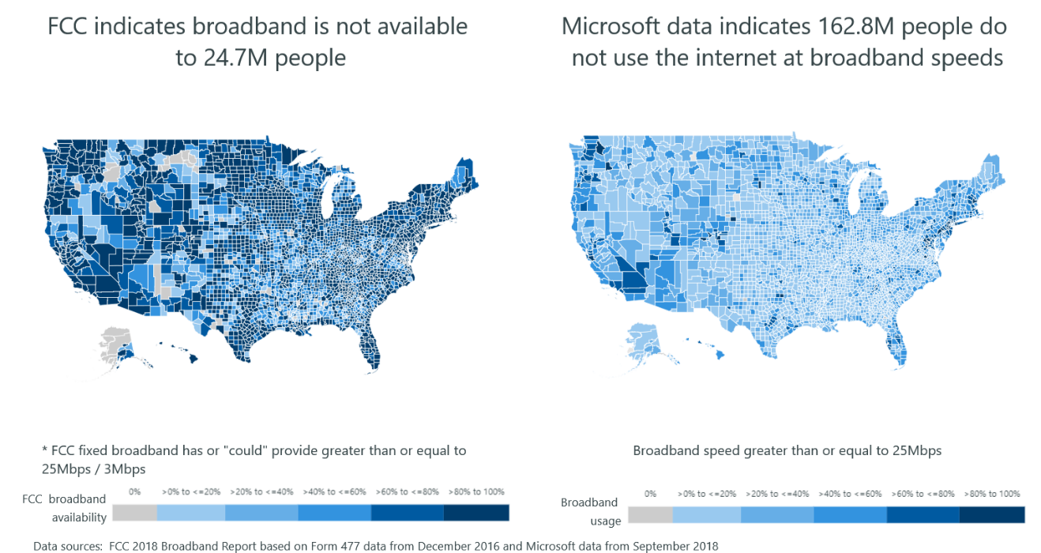
Who defines who has broadband?

Slide 5
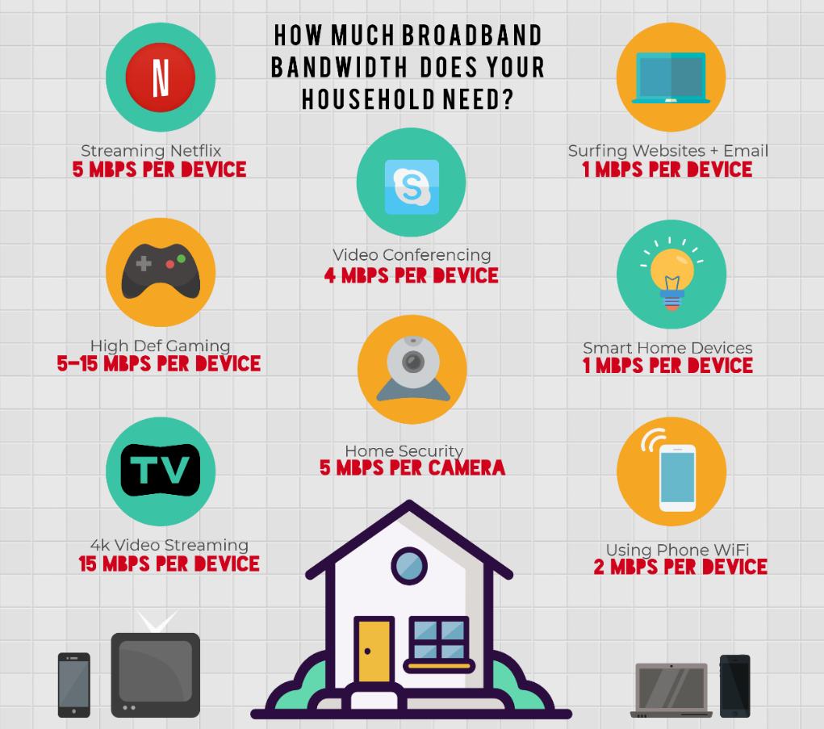
Bandwidth needs add up fast
AFFORDABILITY
ACCESSIBILITY
RELIABILITY

Slide 6
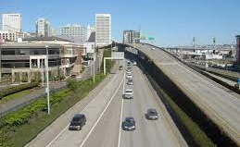
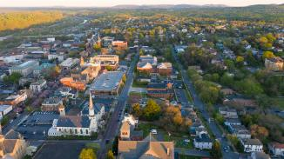

Broadband 101- The Basics
SYMMETRICAL- When the upload and download speeds are the same (150/150mbps)
ASYMMETRICAL- When the upload and download speeds are different (25/3mbps)
BACKBONE- The large trunk lines of network infrastructure that connect thousands of small networks to the worldwide Internet.
  Think of a network as a highway system- The backbone is the Interstate highway that connects entire regions at very high capacities
MIDDLE MILE- The middle mile is the section of a network that connects local, last mile networks to the backbone of the Internet
  This would be the roads in and out of town, major arterials, and streets.
LAST MILE- The link from the network to the customer premise.
  This would be from the street down the driveway to the home or business.

Slide 7
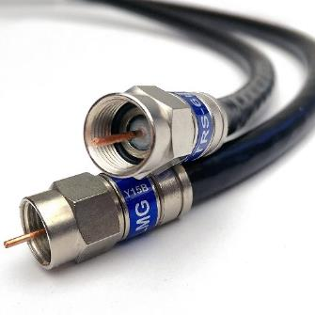
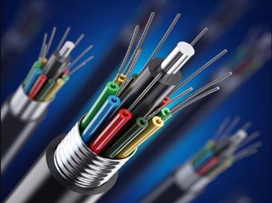
Broadband Technologies- Wired
TWO MAJOR MEANS OF CONNECTION: WIRED & WIRELESS
WIRED CONNECTIONS
Copper Connections
  Twisted Pair Telephone Lines/DSL (Capacity .5 -115 Mbps)
  Coaxial Cable (Capacity 10-1,000 Mbps)
Fiber Optic Cable
  Hair-thin strands of glass
  Future proof: not yet found the bandwidth limitation!
  Technology gets upgraded to increase capacity
  Low Depreciation Characteristics

Slide 8
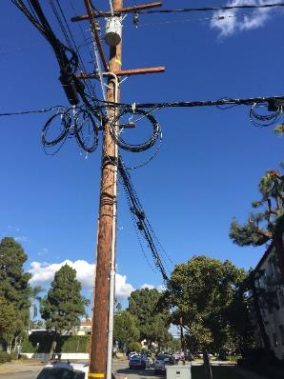
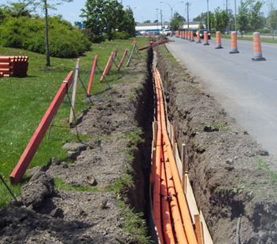
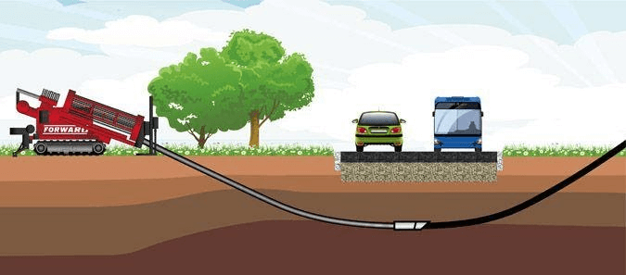

Wired Network Deployment
AERIAL
PLOW / TRENCHED
DIRECTIONAL DRILLED / BORED
MICRO TRENCH
CONDUIT (Dig Once Policies!)

Slide 9
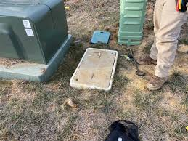
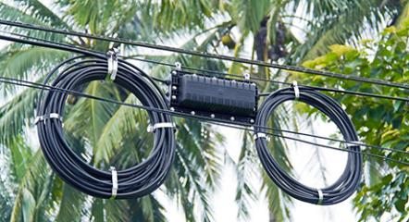
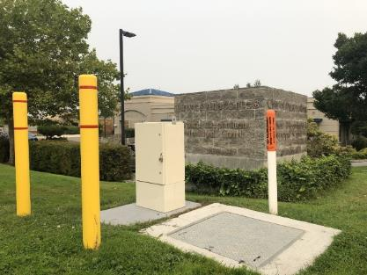
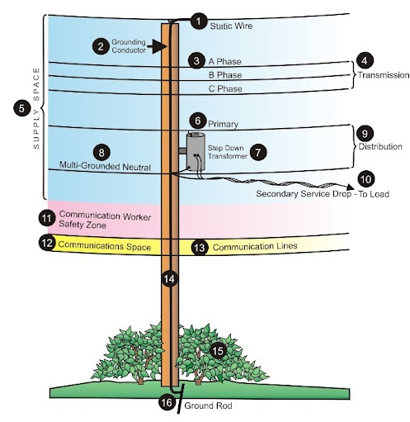
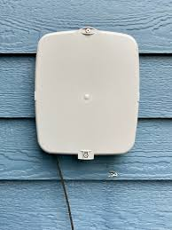
Wireline Broadband Around Town
Splice case and extra line
Hand hole
Fiber Cabinet
Communications lines are
the lowest on power poles
ONT
Optical Network Terminal

Slide 10

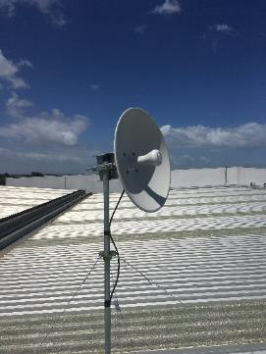
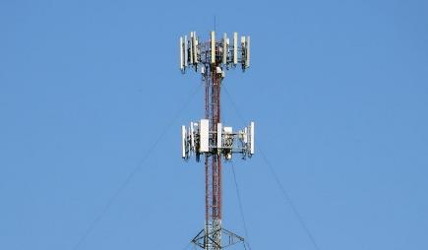
Broadband Technologies
WIRELESS CONNECTIONS
Satellite (Traditional/Low Earth Orbit)
  Traditional – Direct TV, HughesNet, Dish
  Low Earth Orbit (LEO) – StarLink
  Useful for very remote regions or difficult terrain
  Connection speeds may not meet future needs and these technologies suffer frequent problems with latency and interruptions
Fixed Wireless
  Provides middle range speeds
  Licensed and Unlicensed options
  Requires tower infrastructure in addition to possible fiber backbone/backhaul connection
Mobile Wireless
  Requires cell towers, many require fiber backhaul connections
  Traditional services available through major service providers
  Network operators manage and control the data caps

Slide 11
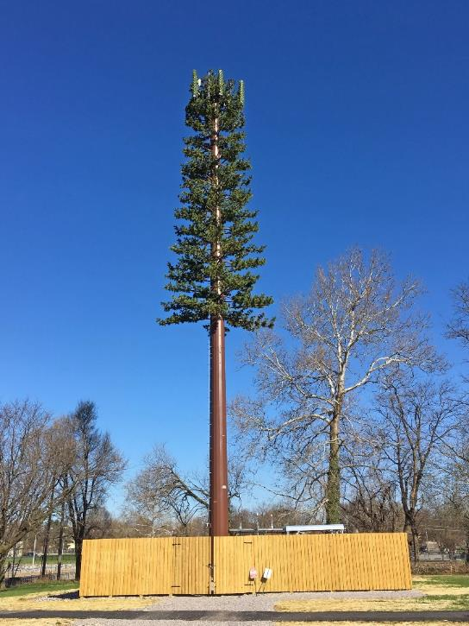
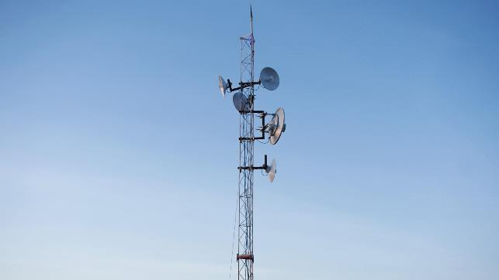
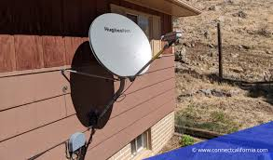
Wireless Broadband Around Town
Macro Tower
An out of place tree
Satellite Dish
Wireless Receiver

Slide 12
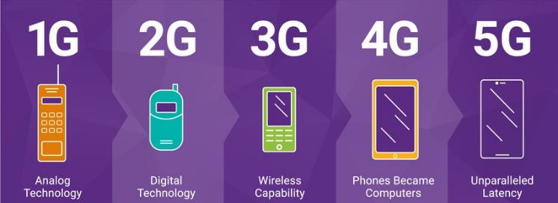
What is 5G Anyway?
THE DIFFERENCE BETWEEN 4G AND 5G:
It’s all about the density of wavelength used
  4G and 4G(LTE) is lower frequency and carries less data but is better over longer distances. The ‘G’ stands for Generations
  5G is a combination of lower and higher frequencies and can carry more data but only over short distances
  We expect mobile internet to be far more available and faster, especially as these systems are rolling out in urban areas.
  Opens the door for smart regional solutions like smart cars
Private LTE – Type of closed cellular network operated by private organizations
CBRS – Citizens Broadband Radio Service: A private network utilizing a band of radio frequencies by licensed operators

Slide 13
Broadband 101 – More terms to know
SPEED TEST LATENCY THROTTLING DATA CAPS
DARK FIBER VS. LIT FIBER
FIBER TO THE HOME, FIBER TO THE PREMISE, FIBER TO THE X
FTTH FTTP FTTX
GIGABIT PASSIVE OPTICAL NETWORK ACTIVE ETHERNET OPTICAL NETWORK
CPE (CUSTOMER PREMISE EQUIPMENT) WIFI

Slide 14

What makes up a network?
THE ACCESS NETWORK
THE MIDDLE MILE NETWORK
THE LONG HAUL NETWORK

Slide 15
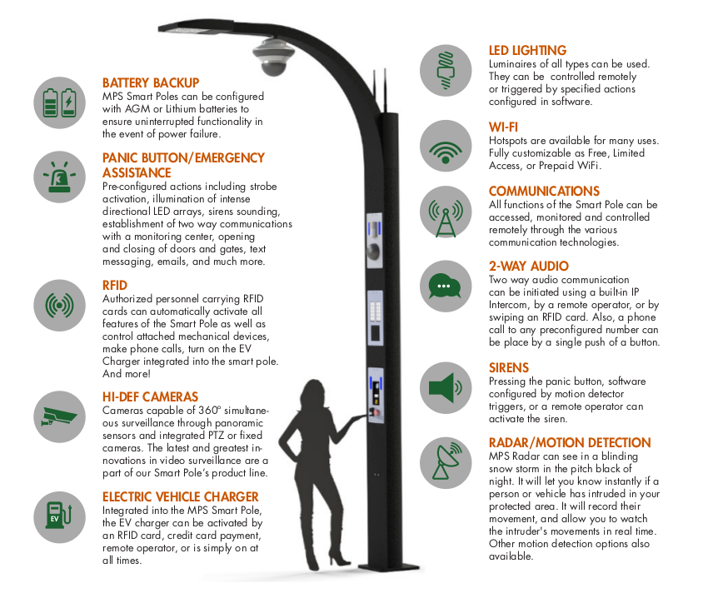
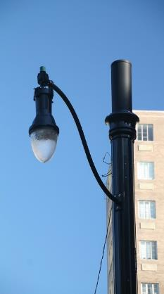
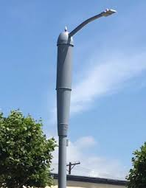
Bringing Technology to the streets

Slide 16
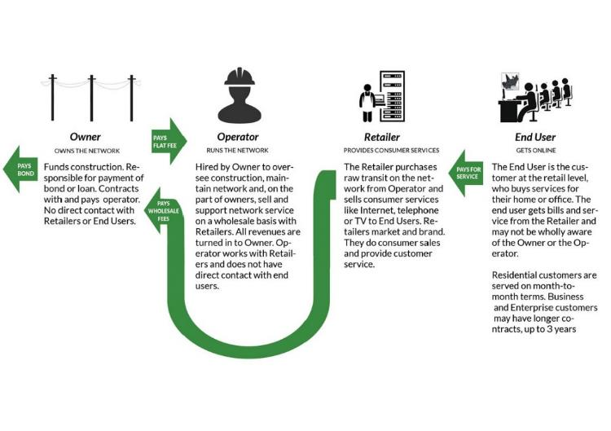
Open Access
OPEN ACCESS NETWORK
When a Network is open to many independent service providers all the way to the end user on an equal basis
CLOSED NETWORK
When a Network is only available to one service provider
Why NoaNet supports the deployment of Open Access Networks:
  Increases competition among ISPs
  Provides the best value for the consumers
  Decreases service costs for end users through a competitive market
  Increase in quality of services provided
  Protects public investment against an ISP that fails to meet standards
  If one ISP fails to meet standards, customers move to different ISP

Slide 17
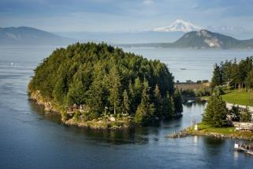


The Persistently Unserved
WHAT ABOUT THE AREAS THAT ARE STILL UNSERVED OR UNDERSERVED?
Difficult terrain requiring trenching or boring can be cost prohibitive
Low population density to recoup the investment made through the sale of services makes investment not feasible
Subsidization will be required for the areas that are still unserved in our state. If there was a way to make it work without significant capital infusion, it would have happened by now!
IT’S NOT JUST ABOUT NETWORK
The Digital Divide is not a rural/urban issue- it is more complex
Affordability, access to technology and know-how can be as big of a barrier as lack of network availability.
We are in a time of unprecedented funding for broadband and communities across the state are stepping up!

Slide 18
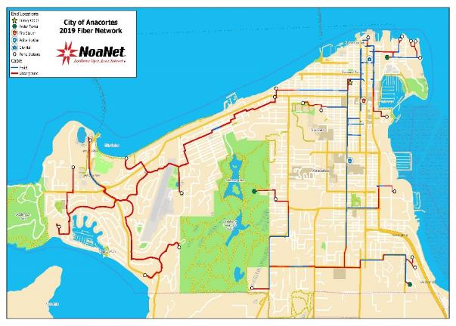
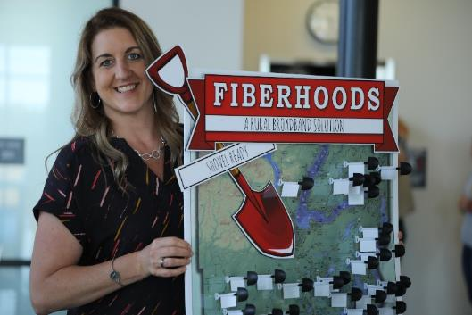
Statewide Fiber Success Stories
City of Anacortes Access Internet
Mason PUD Fiberhood Program
Kitsap PUD LUD Model
Drive-in Wi-Fi Program
Mid-C’s FTTp residential broadband
NG911 Network
Many More!

Slide 19
Thank you.
Bring on the Questions!
Chris Walker
Senior Executive Director, Infrastructure Strategy cwalker@noanet.net

